Slide 1
CS7/8745 : Machine Learning Instructor: Salim Sazzed Department of Computer Science University of Memphis

Slide 2
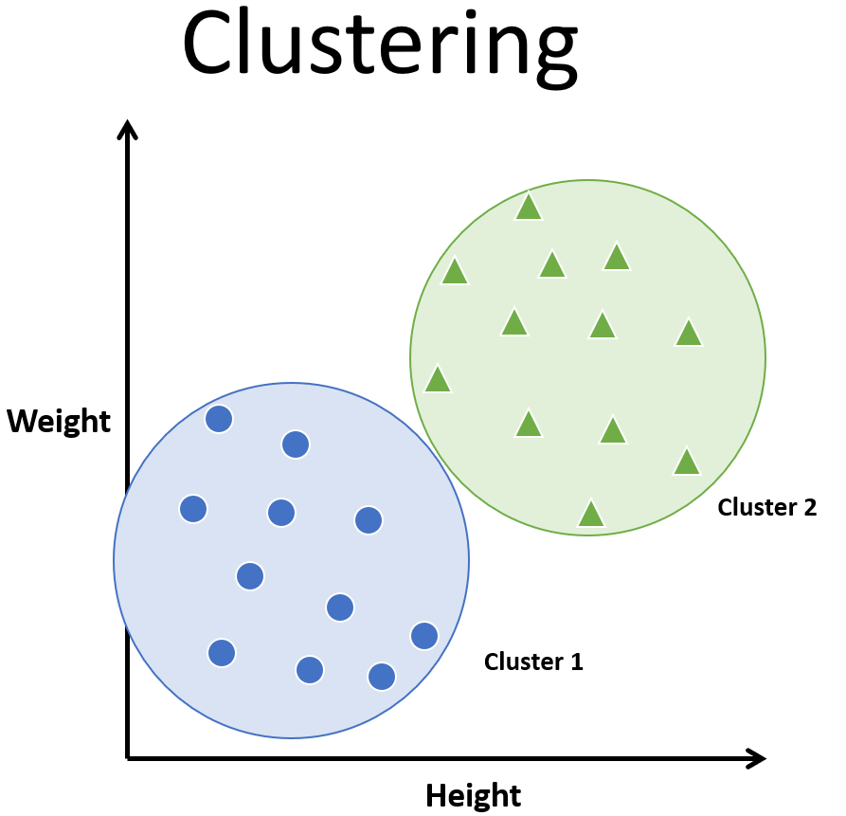
What is clustering?
The process of partitioning data into a set of meaningful sub-classes.
Purpose: Uncover natural grouping or structure
Multiple use cases
stand-alone tool to gain insight into data
preprocessing step for other algorithms
data compression
Outlier detection

Slide 3
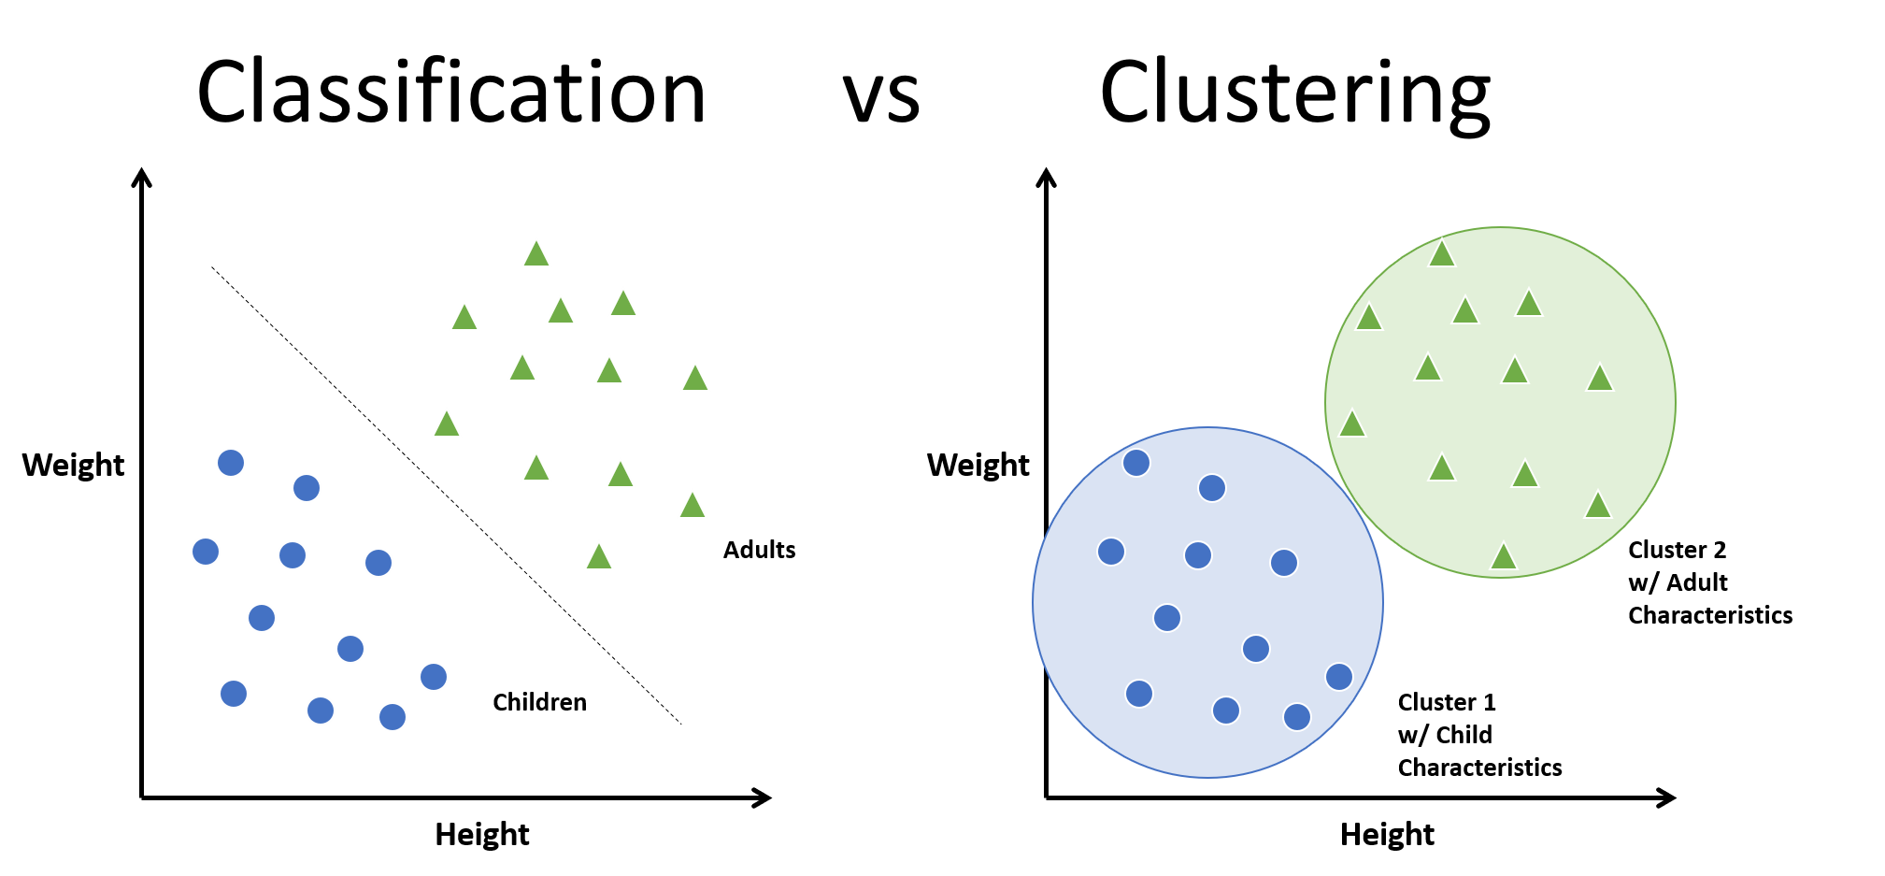

Slide 4
Unsupervised Clustering: K-means
K-means is an unsupervised machine learning algorithm used for clustering data, where it groups similar data points into K clusters based on their features.
K-value: The number of clusters (K) is a user-defined hyperparameter that you must specify before applying the algorithm. Determining the optimal K value can be a challenge.

Slide 5
Centroids: The algorithm uses centroids, which are points in feature space that represent the center of each cluster. Initially, these centroids are either randomly chosen or selected using a more sophisticated initialization method like K-means++.
Hard Clustering: K-means performs hard clustering, meaning each data point is assigned to exactly one cluster, represented by the nearest centroid.
Iterative Process:

Slide 6
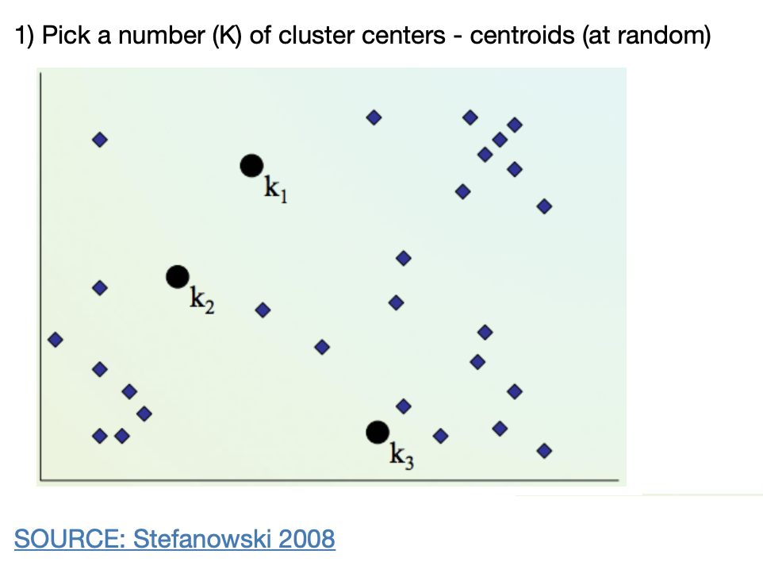
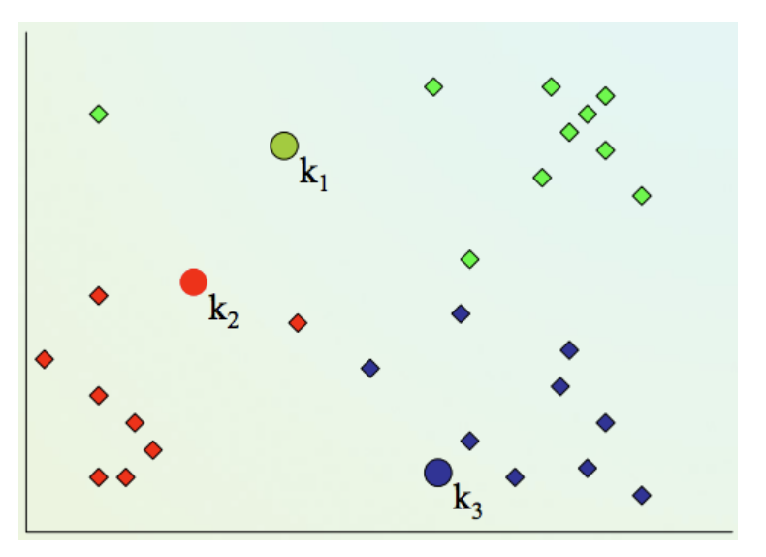
2) Assign every item to its nearest cluster center (e.g. using Euclidean distance)

Slide 7
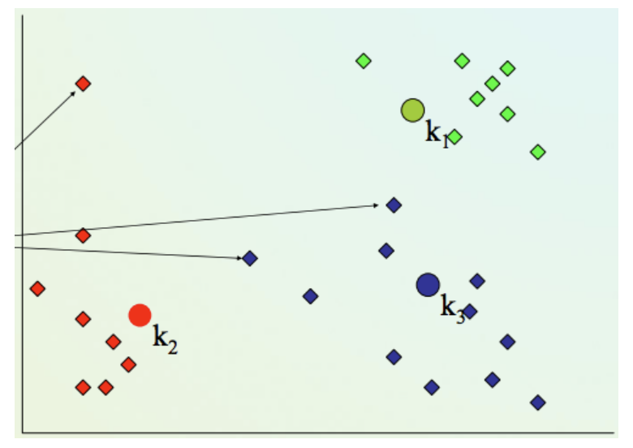
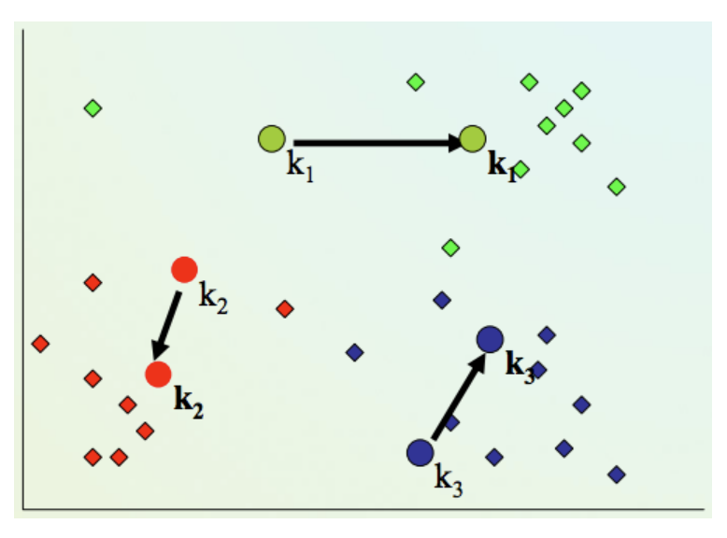
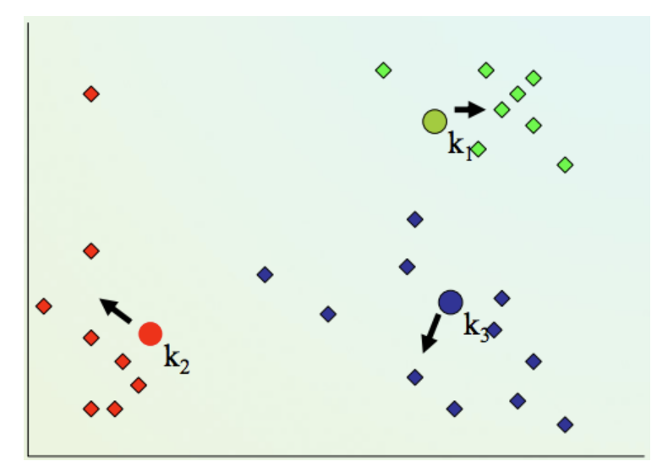
4) Repeat steps 2,3 until convergence (change in cluster assignments less than a threshold)
3. Move each cluster center to the mean of its assigned items

Slide 8
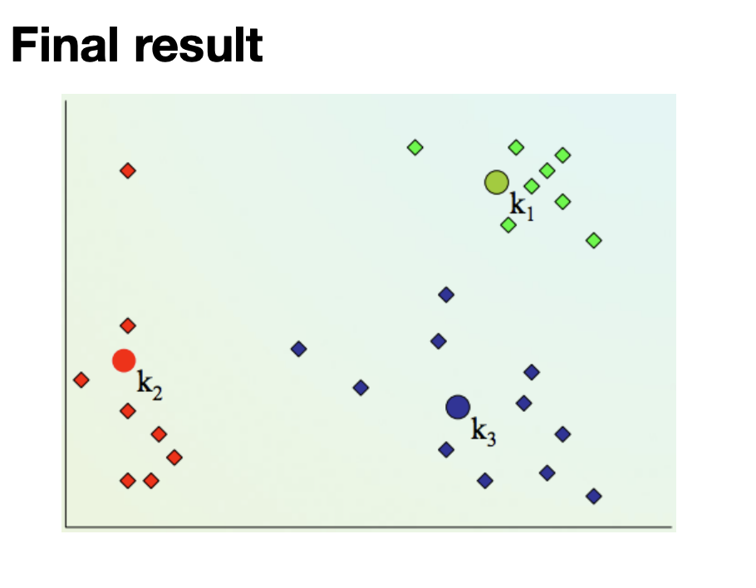

Slide 9
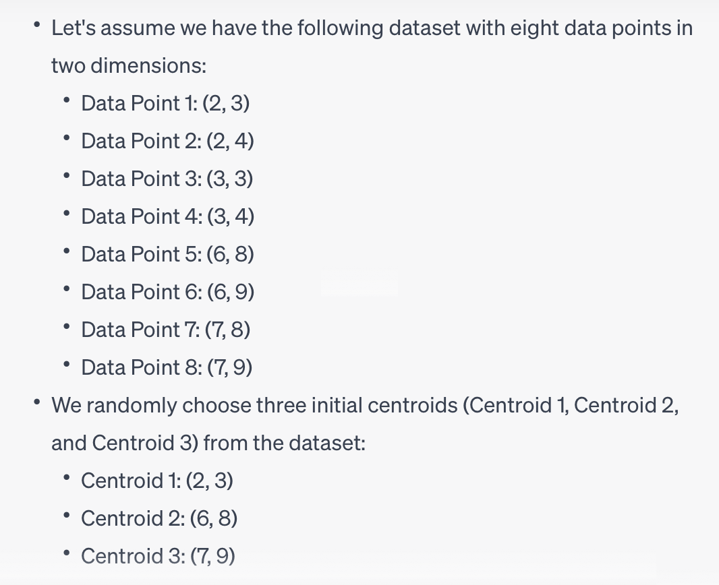

Slide 10
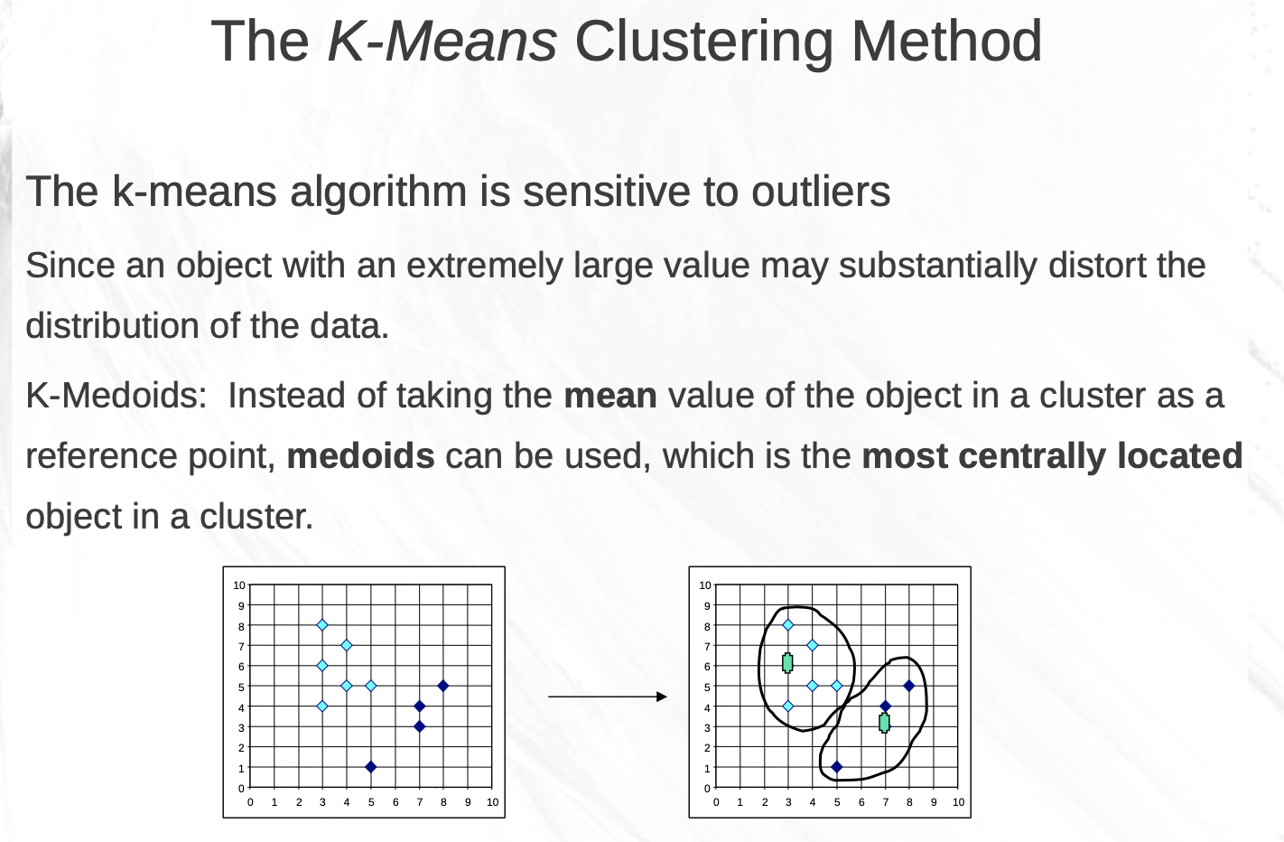
https://csc.csudh.edu/btang/seminar/slides/DBSCAN.pdf

Slide 11
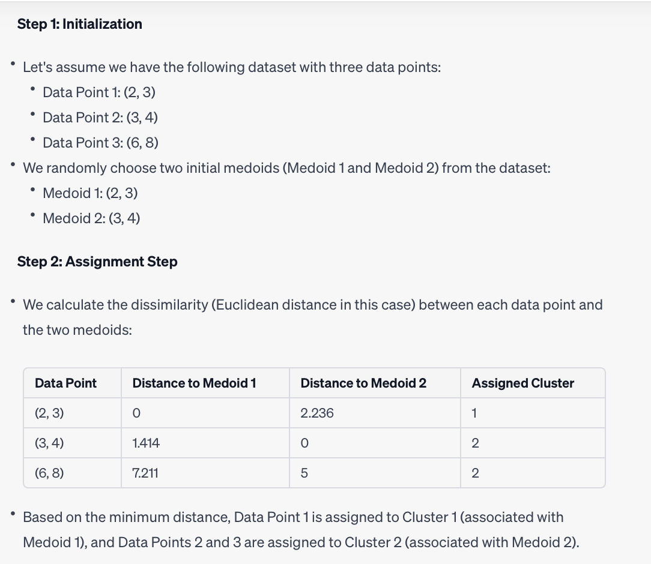

Slide 12
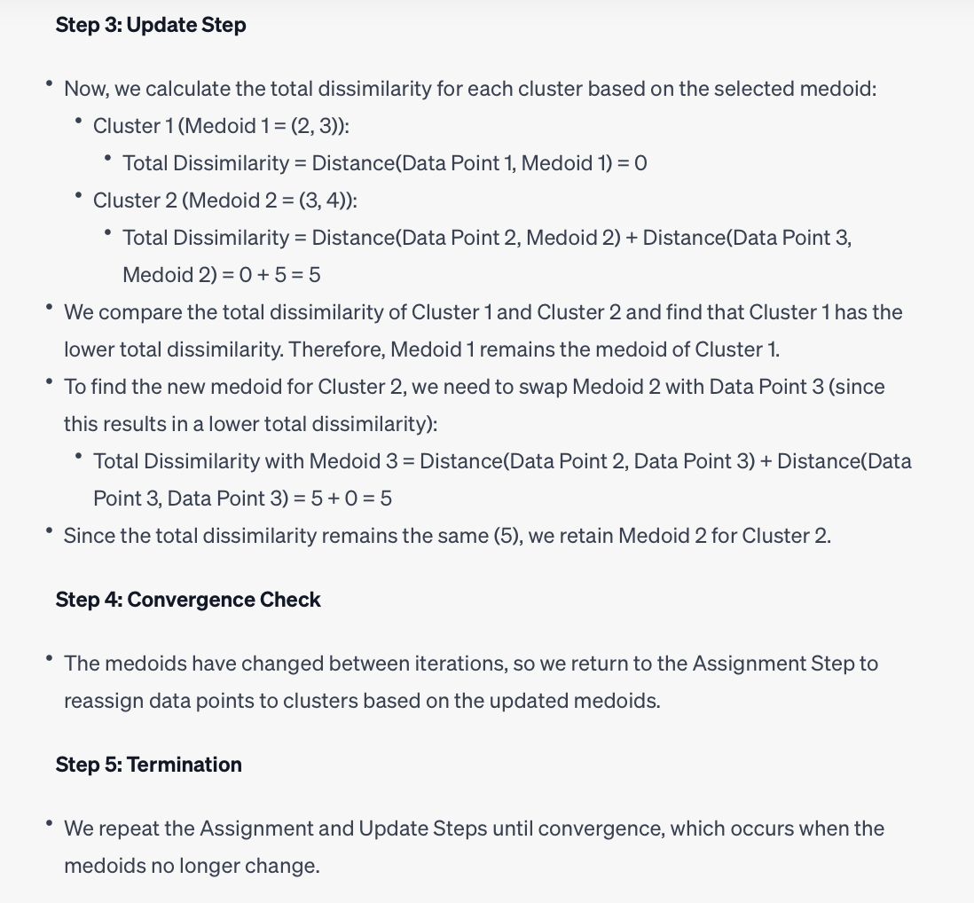

Slide 13
Strengths:
Simplicity and Speed: K-means is relatively simple to understand and easy to implement. It is computationally efficient and works well with large datasets, making it a popular choice for exploratory data analysis and quick clustering tasks.
Scalability: K-means can handle datasets with a large number of data points, making it suitable for large-scale applications.
Interpretable Results: The cluster centroids in K-means provide interpretable cluster representatives. These centroids can be analyzed to gain insights into the characteristics of each cluster.
Hard Clustering: K-means performs hard clustering, where each data point belongs to exactly one cluster. This can be beneficial when you need clear, non-overlapping assignments of data points to clusters.
Suitable for Spherical Clusters: K-means works well when the clusters are roughly spherical and have similar sizes.
Ease of Use: It is straightforward to apply and experiment with K-means, as the only required parameter is the number of clusters (K). Techniques like the elbow method can help determine a reasonable value for K.

Slide 14
Limitations:
Sensitive to Initialization: K-means is sensitive to the initial placement of cluster centroids. Different initializations can lead to different final cluster results. Techniques like K-means++ can mitigate this problem to some extent.
Dependence on K: You must specify the number of clusters (K) in advance. Choosing an inappropriate K value can result in suboptimal clusters, and determining the correct K can be challenging.
Assumption of Spherical Clusters: K-means assumes that clusters are spherical, equally sized, and isotropic, which may not be true for all datasets. It can struggle with clusters of irregular shapes and varying sizes.
Sensitivity to Outliers: Outliers can significantly affect K-means results, as they may pull the centroids away from the true cluster centers.
Limited to Numerical Data: K-means is designed for numerical data and may not work well with categorical or text data without suitable preprocessing.
Doesn't Handle Overlapping Clusters: K-means is not suitable for datasets with overlapping clusters, as it assigns each point to a single cluster.
Local Minima: K-means optimization can converge to local minima, which may lead to suboptimal solutions. Multiple initializations and running the algorithm several times can help mitigate this issue.
Objective Function Minimization: K-means minimizes the within-cluster variance, which may not always correspond to meaningful clusters, especially when clusters have complex shapes.

Slide 15
Support Vector Machine (SVM)
A Support Vector Machine (SVM) is a supervised machine learning algorithm that can be employed for both classification and regression purposes.
SVMs are more commonly used in classification problems and as such, this is what we will focus on in this post.
SVMs are based on the idea of finding a hyperplane that best divides a dataset into two classes, as shown in the image below.
.

Slide 16
History of SVM
SVM is related to statistical learning theory
SVM was first introduced in 1992 [1]
SVM becomes popular because of its success in handwritten digit recognition
1.1% test error rate for SVM. This is the same as the error rates of a carefully constructed neural network, LeNet 4.
See Section 5.11 in [2] or the discussion in [3] for details
SVM is now regarded as an important example of “kernel methods”, one of the key area in machine learning
Notes:
First introduced in COLT-92 by Boser, Guyon and Vapnik
COLT = computational learning theory
B. Scholkopf et al. ICANN 96. 47-52.

Slide 17
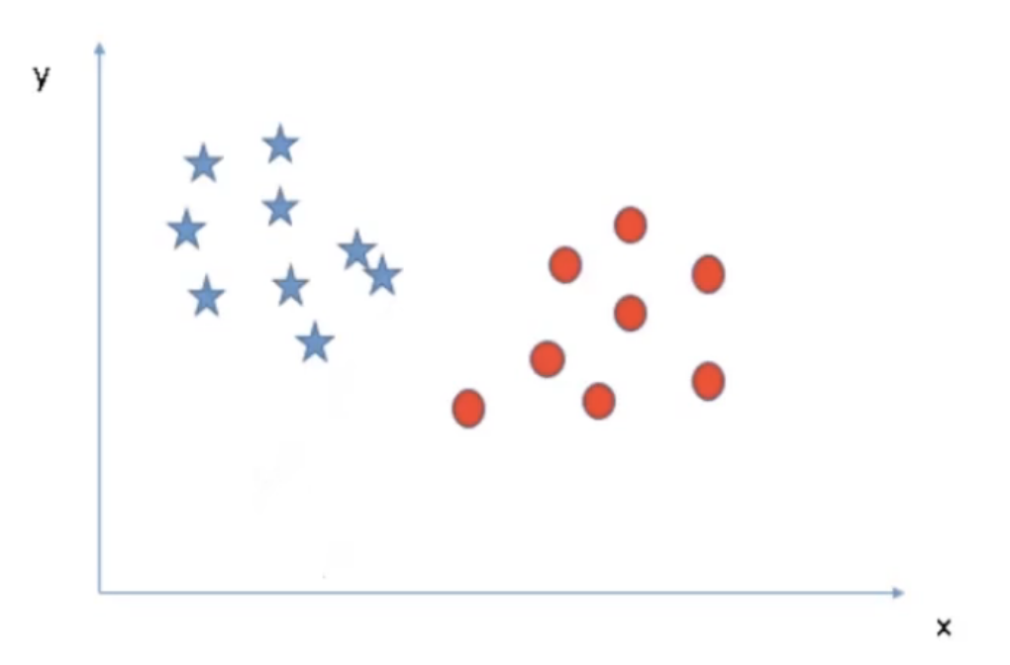
For a classification task with only two features, you can think of a hyperplane as a line that linearly separates and classifies a set of data.
Intuitively, the further from the hyperplane our data points lie, the more confident we are that they have been correctly classified.
We therefore want our data points to be as far away from the hyperplane as possible, while still being on the correct side of it.

Slide 18
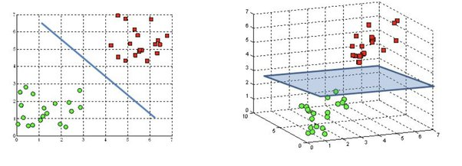
A hyperplane is a decision boundary that differentiates the two classes in SVM.
A data point falling on either side of the hyperplane can be attributed to different classes.
The dimension of the hyperplane depends on the number of input features in the dataset. If we have 2 input features the hyper-plane will be a line. likewise, if the number of features is 3, it will become a two-dimensional plane.

Slide 19
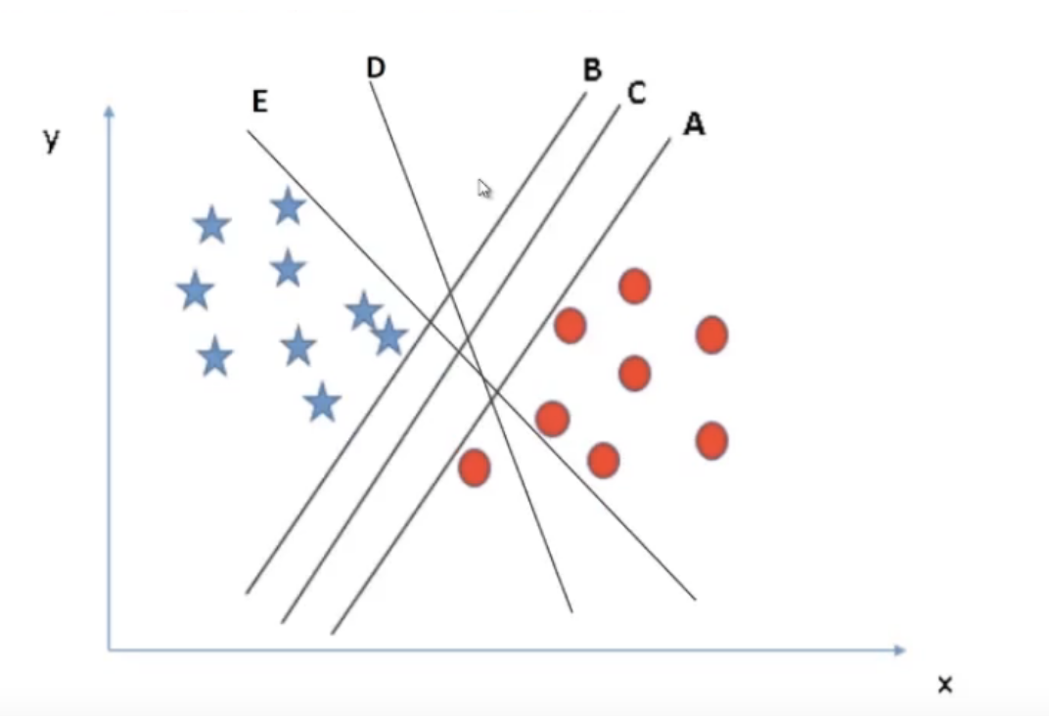

Slide 20
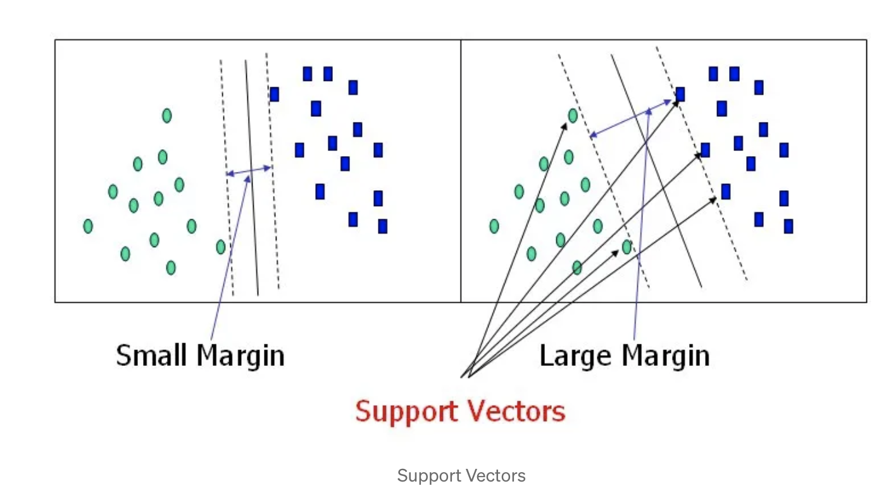
Support vectors are data points that are closer to the hyperplane and influence the position and orientation of the hyperplane. Using these support vectors, we maximize the margin of the classifier. Deleting the support vectors will change the position of the hyperplane. These are the points that help us build our SVM.

Slide 21
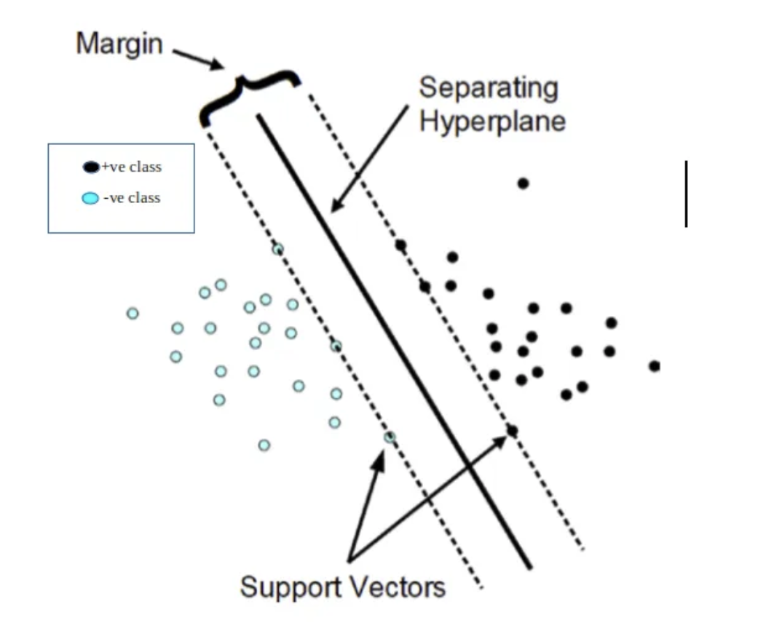
The objective of the support vector machine algorithm is to find a hyperplane in an N-dimensional space(N — the number of features) that distinctly classifies the data points.
Support Vector Machines (SVMs) use a mathematical optimization problem to find the optimal hyperplane that separates different classes in a dataset.
The primary equation for SVM training involves maximizing the margin while minimizing classification errors.

Slide 22
Classification
Class labels are denoted as -1 for negative class and +1 for positive class in SVM.
The final optimization problem that we shall have derived at the end of this article and what SVM solves to fit the best parameters is:
The optimization problem
The margin (M) is inversely proportional to the norm of the weight vector (w) and can be represented as M = 1 / ||w||.
Minimize: 1/2 * ||w||²
Subject to: yᵢ(w · xᵢ + b) ≥ 1 for all i = 1 to N
Where we have N number of samples,

Slide 23
Hinge Loss (Classification): The hinge loss is used for classification tasks in SVM. It measures the loss associated with a data point being misclassified or being too close to the decision boundary.
The hinge loss for a single data point (xᵢ, yᵢ) is defined as follows:
L(yᵢ, f(xᵢ)) = max(0, 1 - yᵢ * f(xᵢ))
- L(yᵢ, f(xᵢ)) is the hinge loss for the data point.
- yᵢ is the true class label, which is typically +1 or -1.
- f(xᵢ) is the output of the SVM model for the data point.
The max function ensures that if the data point is correctly classified (i.e., yᵢ * f(xᵢ) ≥ 1), the loss is 0. Otherwise, the loss increases linearly with the distance from the margin.

Slide 24
Soft Margin (C Parameter): In practical scenarios, data may not be perfectly separable by a hyperplane. SVM can be regularized using a parameter called "C" to allow for some misclassifications. A smaller C results in a larger margin but may allow some misclassifications, while a larger C value reduces the margin to minimize classification errors.

Slide 25
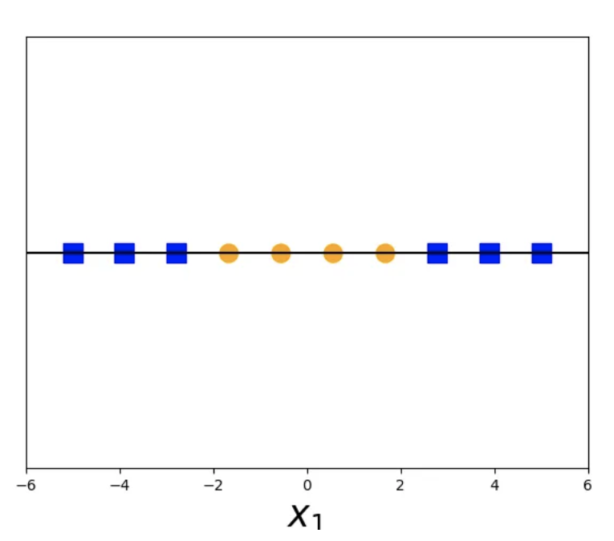
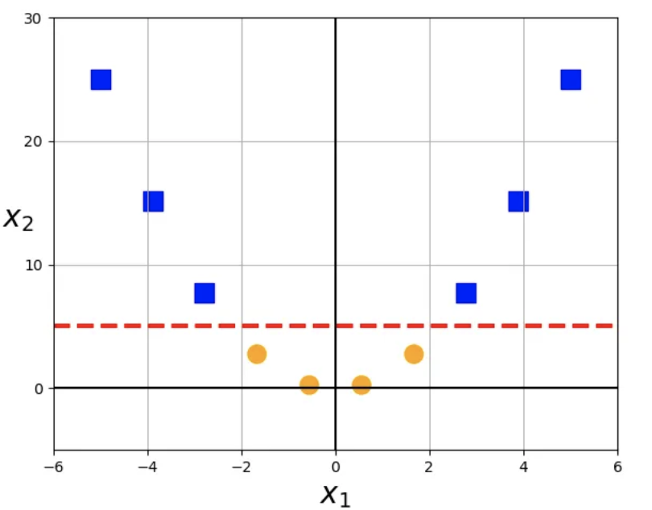
Kernel Trick: SVM can handle non-linearly separable data by mapping the feature space into a higher-dimensional space using kernel functions

